Slide 1
Linear Regression

Slide 2
Contents
Linear Regression
Types of Linear Regression
Simple Linear Regression
Multiple Linear Regression

Slide 3
Linear Regression: Definition
Regression analysis is used to Predict the value of a dependent variable based on the value of at least one independent variable
Explain the impact of changes in an independent variable on the dependent variable
Linear Regression is a supervised machine learning algorithm.
It tries to find out the best linear relationship that describes the data you have.
It assumes that there exists a linear relationship between a dependent variable and independent variable(s).
The value of the dependent variable of a linear regression model is a continuous value i.e. real numbers.
Dependent variable/ Output Variable :
the variable we wish to predict or explain
Independent variable/ Input Variable :
the variable used to explain the dependent variable

Slide 4
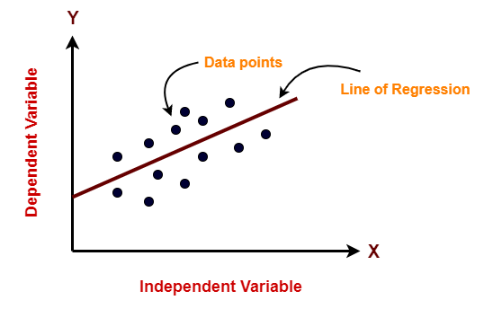
Simple example of Linear Regression

Slide 5
Types of Linear Regression:
Simple Linear regression
Multiple Linear Regression

Slide 6
Simple Linear Regression
In simple linear regression, the dependent variable depends only on a single independent variable.
For simple linear regression, the form of the model is-
Y = β₀ + β₁X
Y is a dependent variable.
X is an independent variable.
β₀ and β₁ are the regression coefficients.
β₀ is the intercept or the bias that fixes the offset to a line.
β₁ is the slope or weight that specifies the factor by which X has an impact on Y.

Slide 7
Possible values of ß1
Case-01: β₁ < 0
It indicates that variable X has negative impact on Y.
If X increases, Y will decrease and vice-versa.
Case-02: β₁ = 0
It indicates that variable X has no impact on Y.
If X changes, there will be no change in Y.

Slide 8
Possible values of ß1
Case-03: β₁ > 0
It indicates that variable X has positive impact on Y.
If X increases, Y will increase and vice-versa.

Slide 9
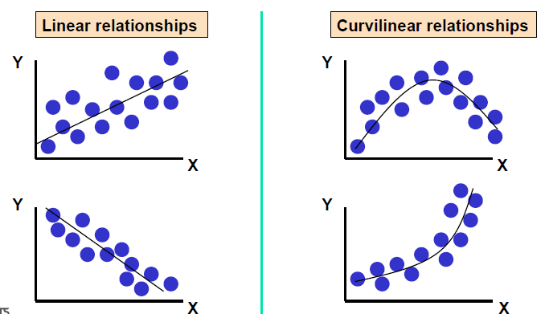
Types of Relationships

Slide 10
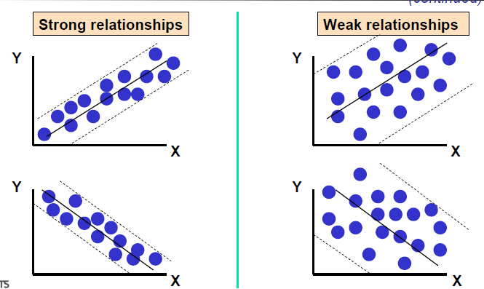
Types of Relationships

Slide 11
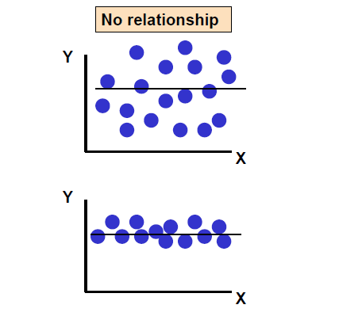
Types of Relationships

Slide 12
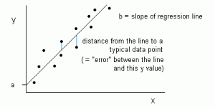
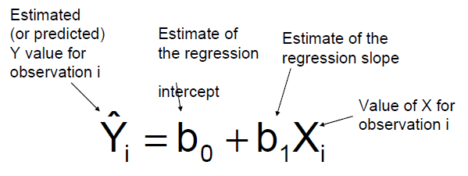
Simple Linear Regression Equation
b1
b0

Slide 13
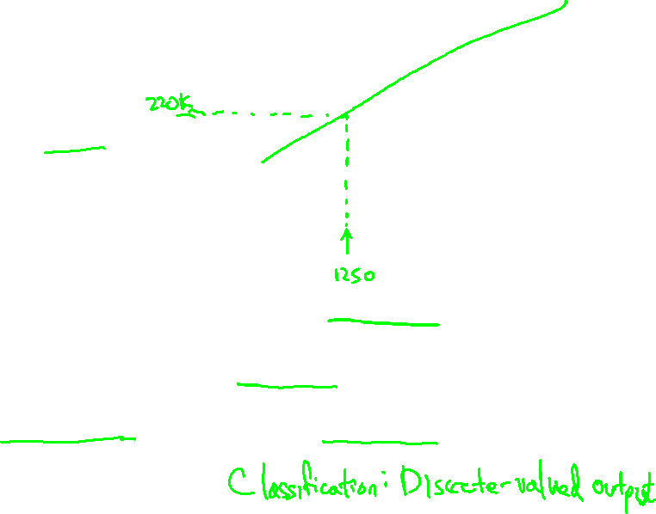
Housing Prices
(Portland, OR)
Price
(in 1000s of dollars)
Size (feet²)
Supervised Learning
Given the “right answer” for each example in the data.
Regression Problem
Predict real-valued output

Slide 14
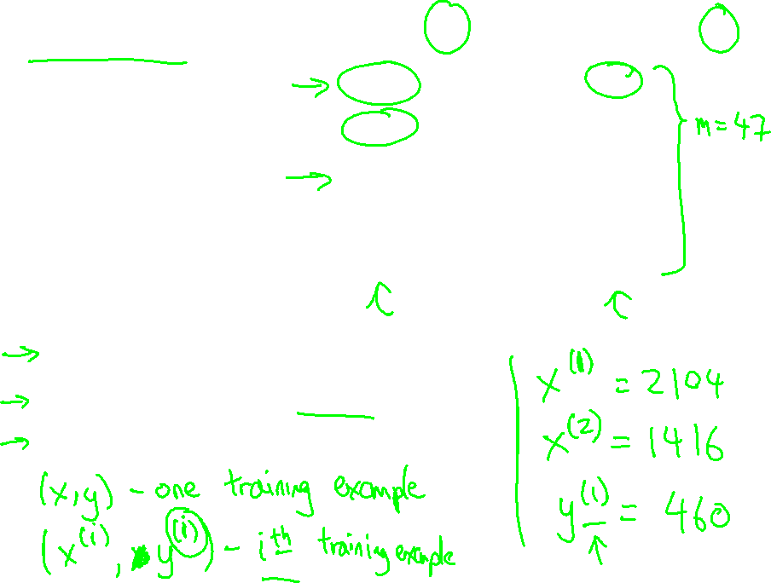
Training set of
housing prices
(Portland, OR)
Size in feet² (x) | Price ($) in 1000's (y)
2104 | 460
1416 | 232
1534 | 315
852 | 178
… | …
Notation:
m = Number of training examples
x’s = “input” variable / features
y’s = “output” variable / “target” variable

Slide 15
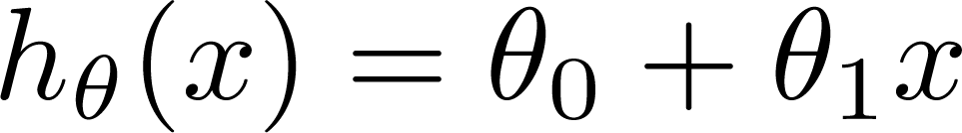

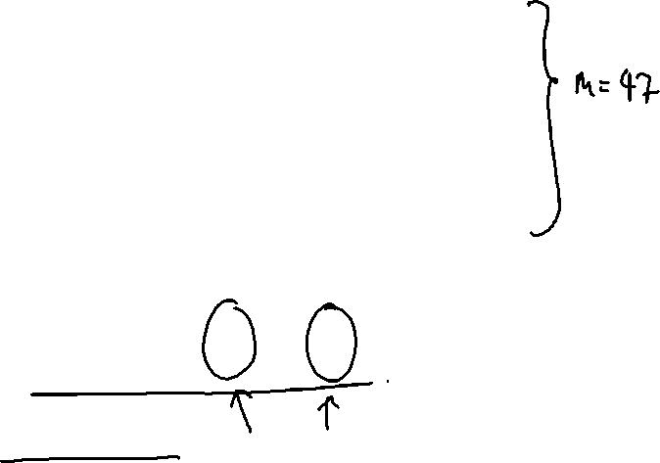
Training Set
Size in feet² (x) | Price ($) in 1000's (y)
2104 | 460
1416 | 232
1534 | 315
852 | 178
… | …
Hypothesis:
‘s: Parameters
How to choose ‘s ?

Slide 16
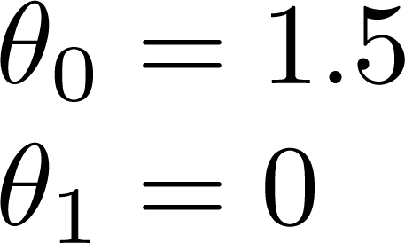
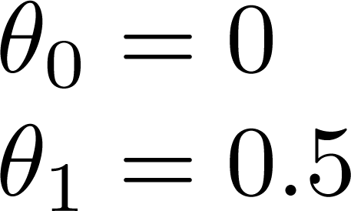
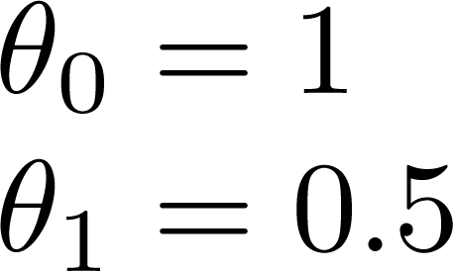
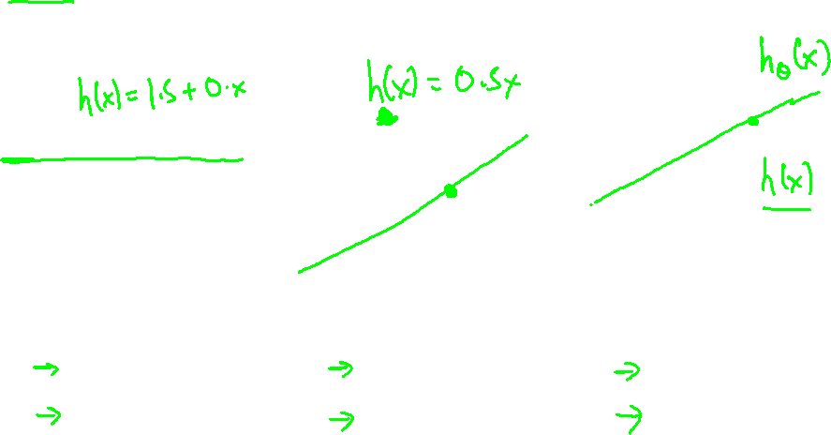

Slide 17
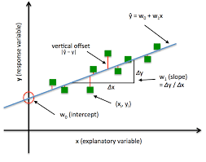
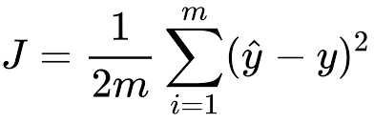
Error between Actual and Predicted value/ Cost function
yˆ is predicted value
Y is observed or actual value
Goal is to minimize error or cost function between predicted and actual value

Slide 18
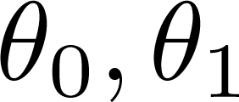


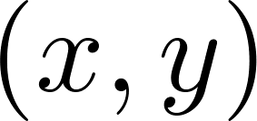
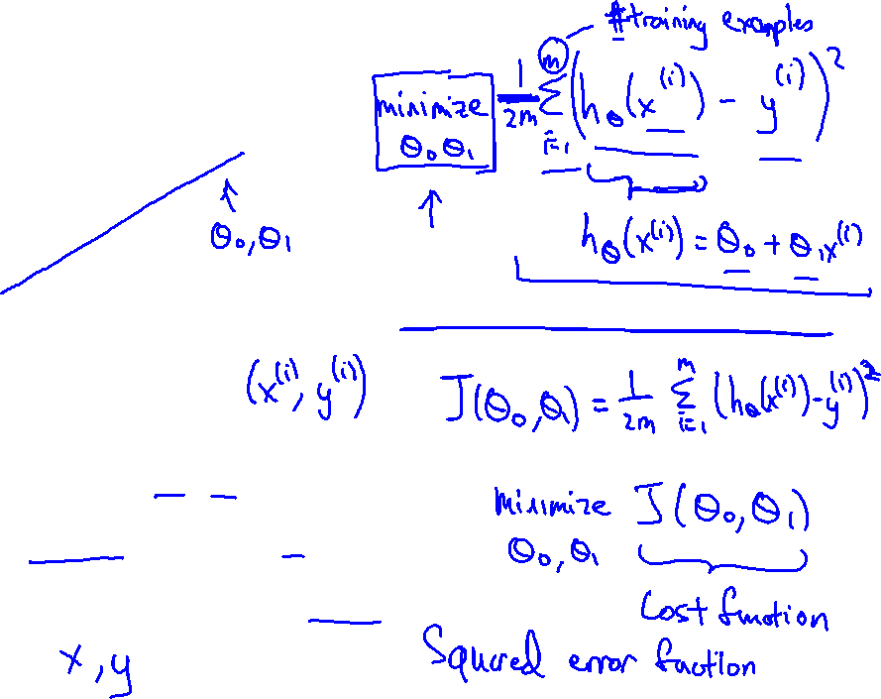
y
x
Idea: Choose so that is close to for our training examples

Slide 19
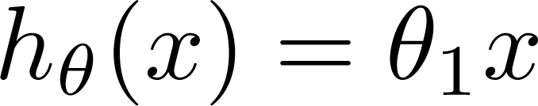

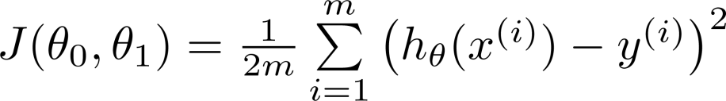
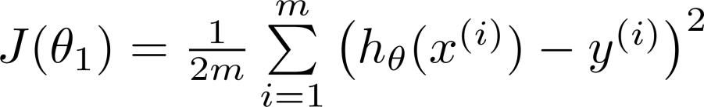
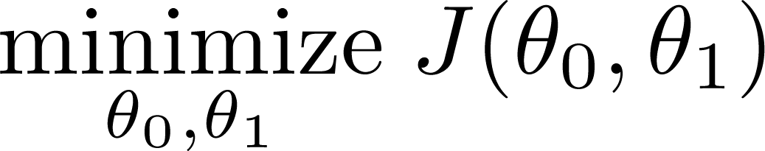
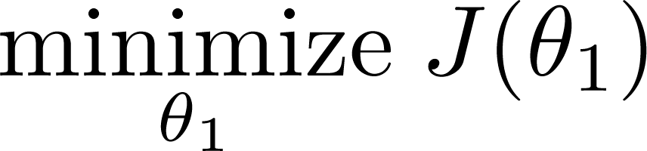
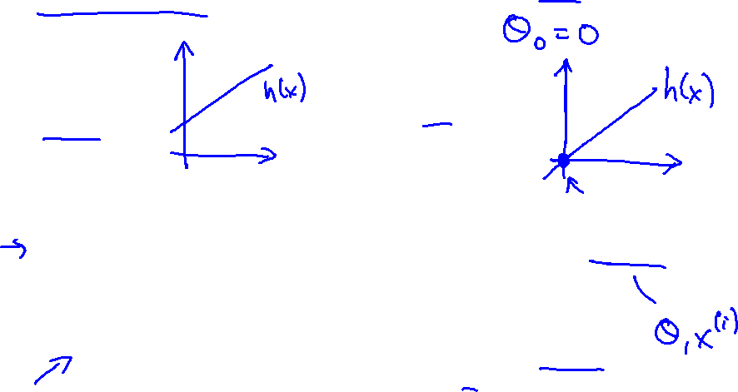
Simplified
Hypothesis:
Parameters:
Cost Function:
Goal:

Slide 20





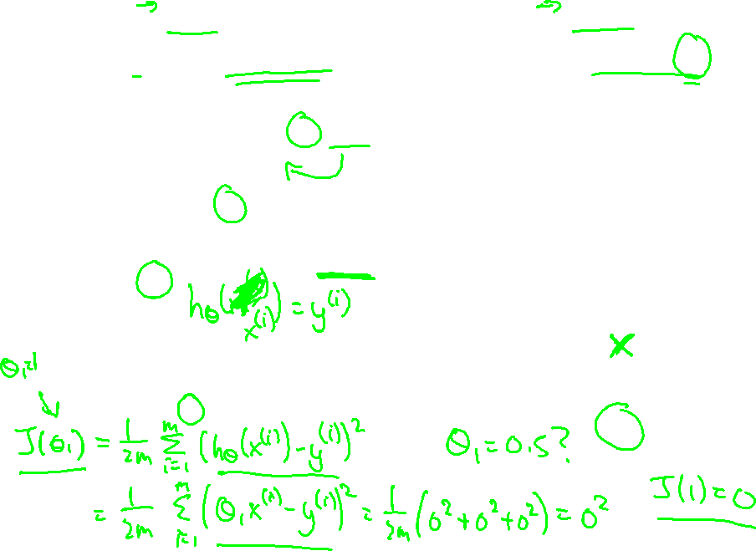
(for fixed , this is a function of x)
(function of the parameter )
y
x

Slide 21

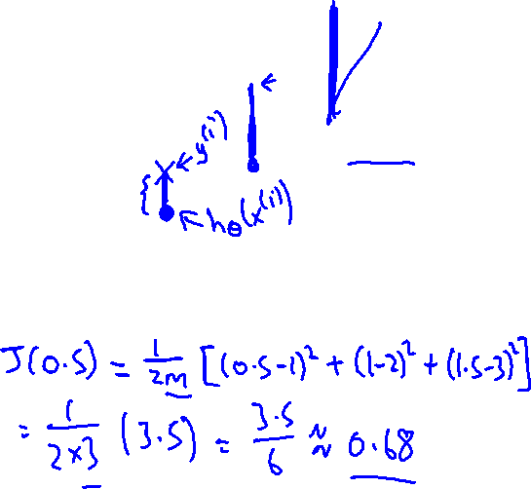
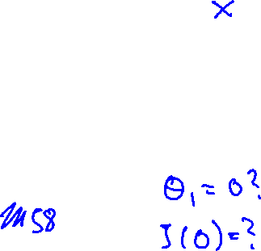
(for fixed , this is a function of x)
(function of the parameter )
y
x

Slide 22

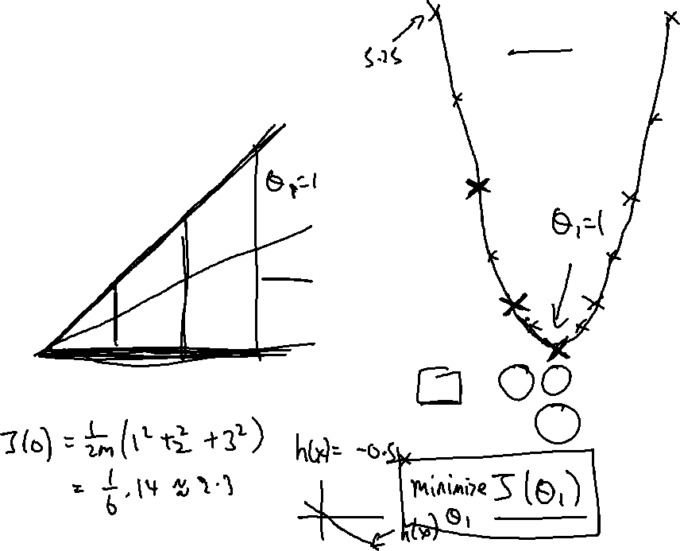
(for fixed , this is a function of x)
(function of the parameter )
y
x

Slide 23
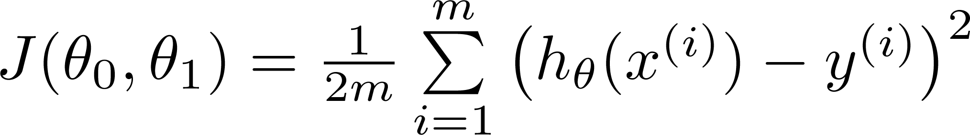

Hypothesis:
Parameters:
Cost Function:
Goal:

Slide 24
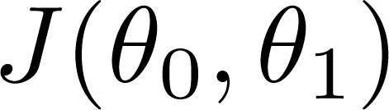
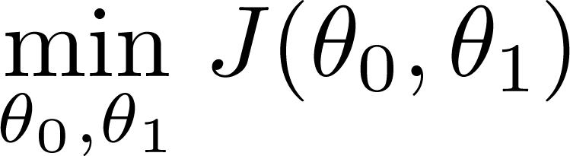
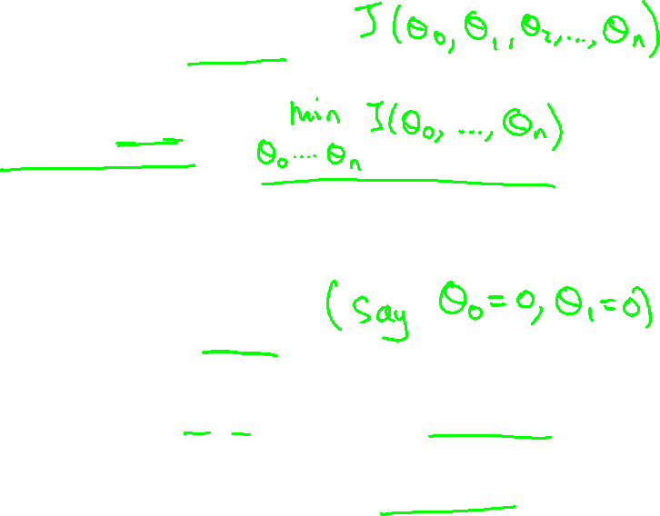
Have some function
Want
Outline:
Start with some
Keep changing to reduce until we hopefully end up at a minimum

Slide 25
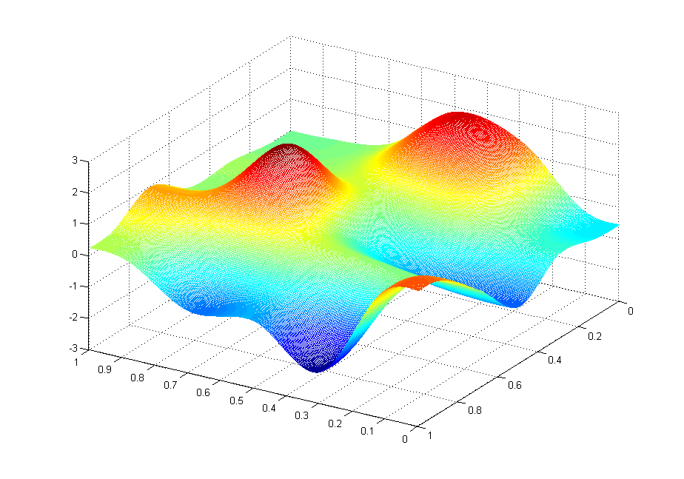

J(θ₀,θ₁)
θ₁
θ₀

Slide 26
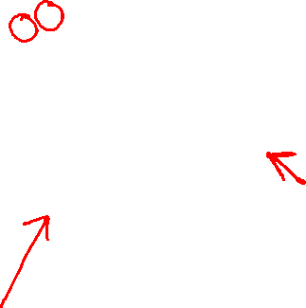
J(θ₀,θ₁)
θ₁
θ₀

Slide 27
Gradient Descent Algorithm
Gradient descent is used to minimize a cost function J(θ) or J(w) parameterized by a model parameters θ or W. The gradient (or derivative) tells us the incline or slope of the cost function. Hence, to minimize the cost function, we move in the direction opposite to the gradient.

Slide 28
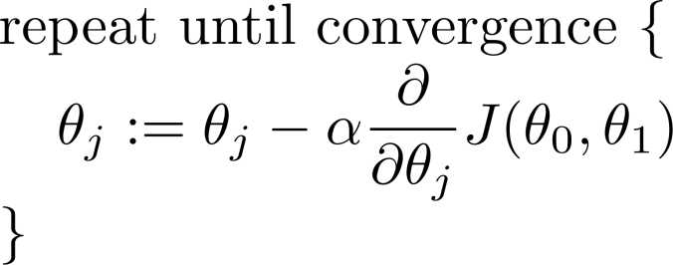
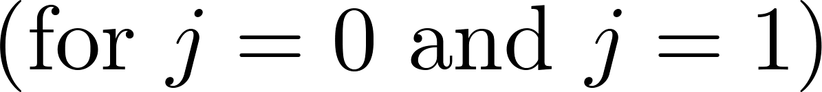
Gradient Descent Algorithm

Slide 29
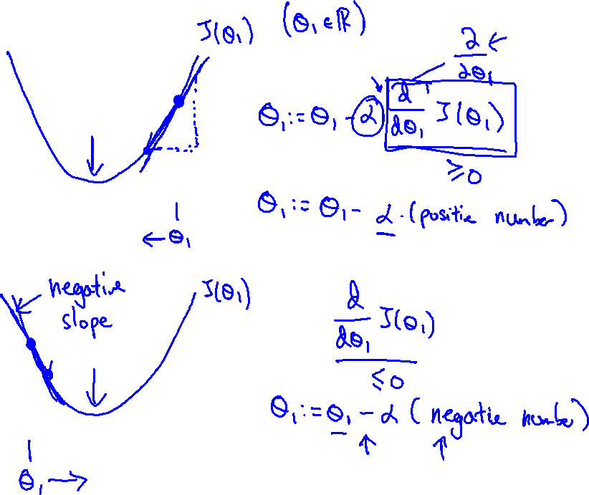

Slide 30
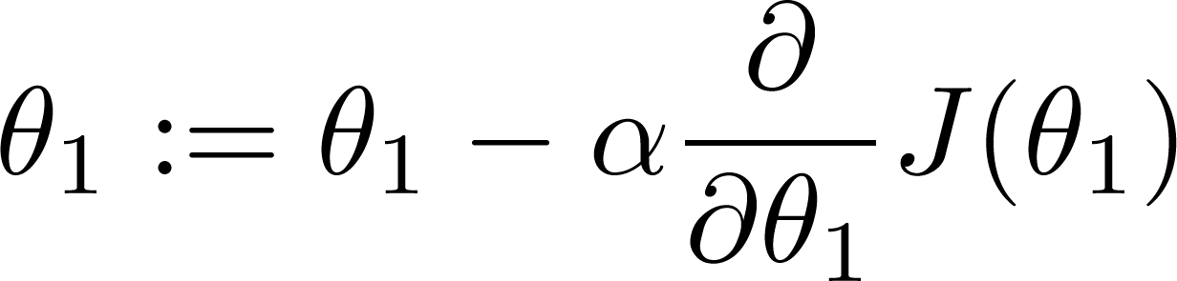
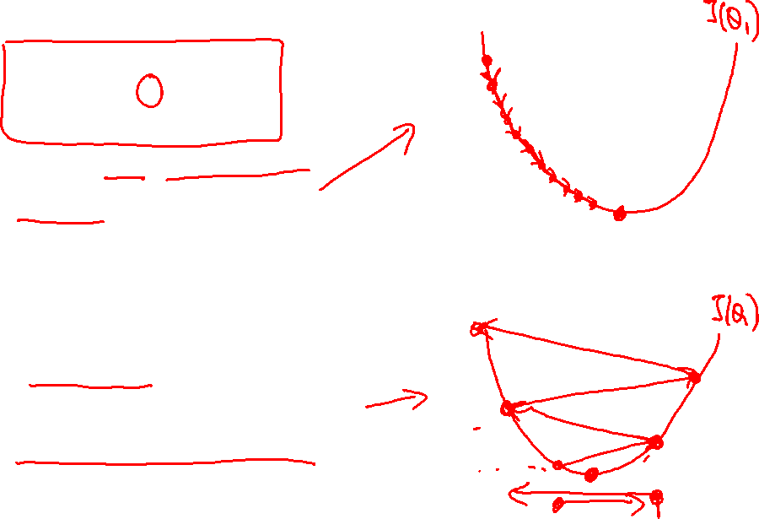
If α is too small, gradient descent can be slow.
If α is too large, gradient descent can overshoot the minimum. It may fail to converge, or even diverge.

Slide 31
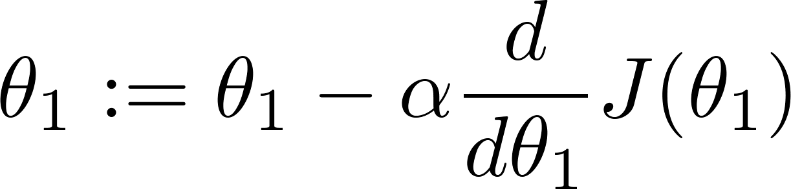
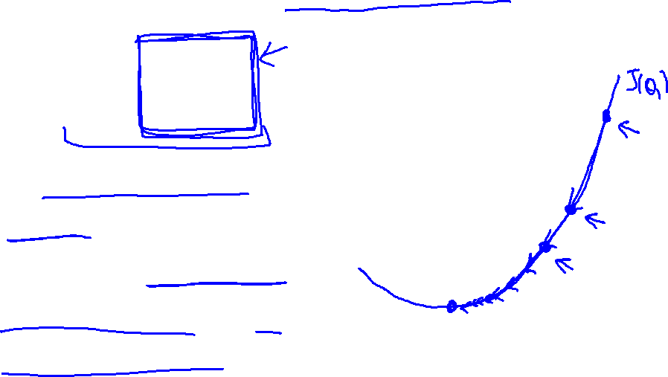
Gradient descent can converge to a local minimum, even with the learning rate α fixed.
As we approach a local minimum, gradient descent will automatically take smaller steps. So, no need to decrease α over time.

Slide 32
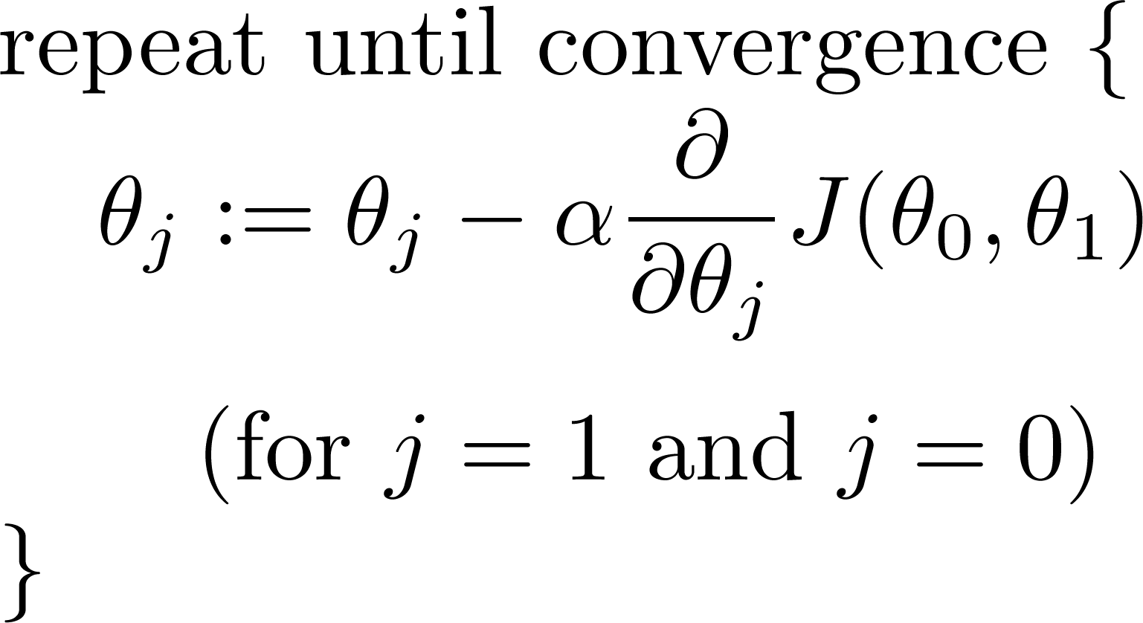
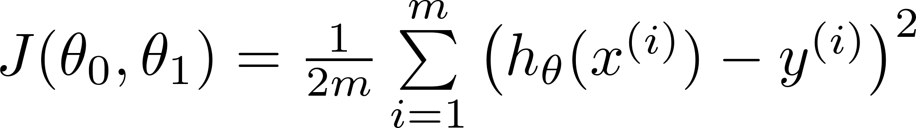
Gradient Descent For Linear Regression
Gradient descent algorithm
Linear Regression Model

Slide 33
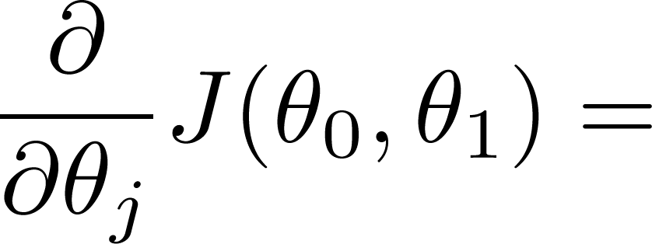
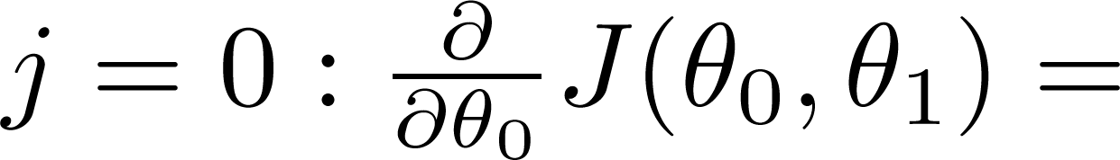
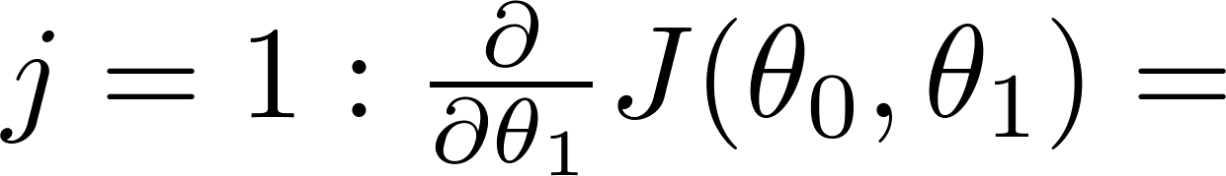
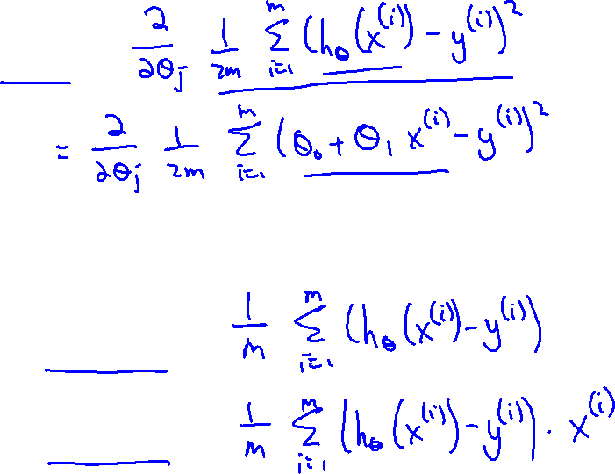

Slide 34
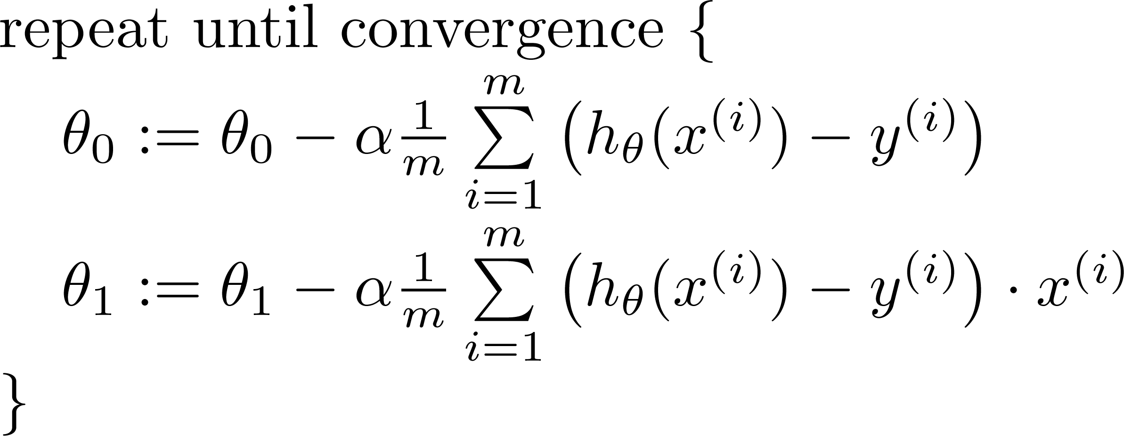

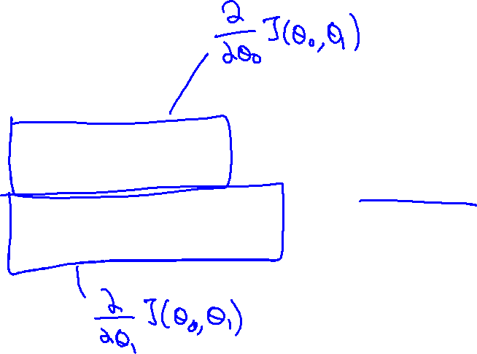
Gradient descent algorithm
update
and
simultaneously

Slide 35

Convex Function

Slide 36





(for fixed , this is a function of x)
(function of the parameters )

Slide 37


(for fixed , this is a function of x)
(function of the parameters )

Slide 38


(for fixed , this is a function of x)
(function of the parameters )

Slide 39


(for fixed , this is a function of x)
(function of the parameters )

Slide 40


(for fixed , this is a function of x)
(function of the parameters )

Slide 41


(for fixed , this is a function of x)
(function of the parameters )

Slide 42


(for fixed , this is a function of x)
(function of the parameters )

Slide 43


(for fixed , this is a function of x)
(function of the parameters )

Slide 44



(for fixed , this is a function of x)
(function of the parameters )

Slide 45
Multiple Linear Regression
In multiple linear regression, the dependent variable depends on more than one independent variables.
For multiple linear regression, the form of the model is-
Y = β₀ + β₁X₁ + β₂X₂ + β₃X₃ + …… + β_{n}X_{n}
Y is a dependent variable.
X₁, X₂, …., X_{n} are independent variables.
β₀, β₁,…, β_{n} are the regression coefficients.
β_{j} (1<=j<=n) is the slope or weight that specifies the factor by which X_{j} has an impact on Y.

Slide 46
Multiple features (variables).
Size (feet²) | Number of bedrooms | Number of floors | Age of home (years) | Price ($1000)
2104 | 5 | 1 | 45 | 460
1416 | 3 | 2 | 40 | 232
1534 | 3 | 2 | 30 | 315
852 | 2 | 1 | 36 | 178
… | … | … | … | …

Slide 47



Multiple features (variables).
Size (feet²) | Number of bedrooms | Number of floors | Age of home (years) | Price ($1000)
2104 | 5 | 1 | 45 | 460
1416 | 3 | 2 | 40 | 232
1534 | 3 | 2 | 30 | 315
852 | 2 | 1 | 36 | 178
… | … | … | … | …
Notation:
= number of features
= input (features) of training example.
= value of feature in training example.
Notes:
Pop-up Quiz

Slide 48

Hypothesis:
Previously:
For Multiple Linear Regression

Slide 49






Gradient Descent For Multiple Regression
Hypothesis:
Parameters:
Cost function:
Gradient descent:
Repeat
(simultaneously update for every )

Slide 50











New algorithm :
Gradient Descent
Repeat
Previously (n=1):
Repeat
(simultaneously update for
)
(simultaneously update )

Slide 51


For convenience of notation, define .
Multivariate linear regression.

Slide 52









Examples:
 | Size (feet²) | Number of bedrooms | Number of floors | Age of home (years) | Price ($1000)
1 | 2104 | 5 | 1 | 45 | 460
1 | 1416 | 3 | 2 | 40 | 232
1 | 1534 | 3 | 2 | 30 | 315
1 | 852 | 2 | 1 | 36 | 178
1
Notes:
Pop-up Quiz

Slide 53


Gradient descent
“Debugging”: How to make sure gradient descent is working correctly.
How to choose learning rate .

Slide 54




Making sure gradient descent is working correctly.
Example automatic convergence test:
Declare convergence if decreases by less than in one iteration.
No. of iterations

Slide 55


Making sure gradient descent is working correctly.
Gradient descent not working.
Use smaller .
No. of iterations
No. of iterations
No. of iterations
For sufficiently small , should decrease on every iteration.
But if is too small, gradient descent can be slow to converge.

Slide 56

Summary:
If is too small: slow convergence.
If is too large: may not decrease on every iteration; may not converge.
To choose , try

Slide 57

R² value for Regression
As we keep on adding new features, R square value increases.

Slide 58
R-squared and the Goodness-of-Fit
R-squared evaluates the scatter of the data points around the fitted regression line. It is also called the coefficient of determination, or the coefficient of multiple determination for multiple regression. For the same data set, higher R-squared values represent smaller differences between the observed data and the fitted values.
R-squared is the percentage of the dependent variable variation that a linear model explains.
R-squared is always between 0 and 100%:

Slide 59
If independent variables are correlated, then R² value is high
Hence (1- R² ) in Numerator of adjusted R² becomes smaller
Hence adjusted R² decreases

Slide 60
R² value increases when features are added, irrespective of significance of features
Adjusted R² value increases after adding features, only if features are significant i.e. affects dependent variable

